Slide 1
DIABETES PREDICTION USING MACHINE LEARNING
PROJECT BY:
AYESHA RAZA
NAVIOTECH.PVT.LTD

Slide 2
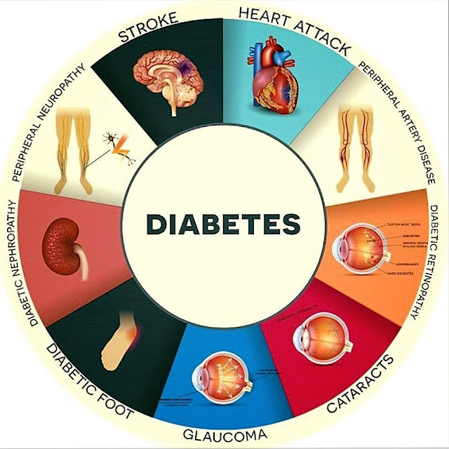
INTRODUCTION
Diabetes is a chronic disease that occurs when the body is unable to properly regulate blood glucose levels. It has become a major global health concern, affecting millions of people worldwide. Early detection and timely treatment are crucial to prevent serious complications such as heart disease, kidney failure, and nerve damage.
With the advancement of technology, Machine Learning (ML) has emerged as a powerful tool in the healthcare sector. It enables the analysis of large medical datasets to identify patterns and make accurate predictions.
This project focuses on using machine learning algorithms to predict the likelihood of diabetes in patients based on various health parameters such as glucose level, blood pressure, BMI, age, and insulin levels. By leveraging these techniques, we aim to assist healthcare professionals in making faster and more accurate diagnoses
This Photo by Unknown Author is licensed under CC BY-NC-ND

Slide 3
PROBLEM STATEMENT
Diabetes is a widespread chronic disease requiring early detection
Traditional diagnosis methods can be slow , costly , and less efficient
Need for an automated and accurate prediction system
Use patient health data (glucose, BMI, age, insulin, etc.)for prediction
Apply machine learning algorithm for classification
Handle challenges like missing data and imbalanced datasets
Improve prediction accuracy and reduce diagnosis time
Assist doctors in faster and better decision making
Diabetes are rapidly increasing global isse
Early detection is crucial to prevent severe complications
Manual diagnosis depends heavily on doctor’s experience

Slide 4
DATA PREPROCESSING
Commonly used dataset id PIMS INDIANS DIABETES DATASET
Available on platforms like Kaggle and UCI Machine Repository
Contains medical records of female patients of Pima Indian Heritage
Total number of instances:768
Number of attributes/features :8 input features+1 output
FEATURES:
Pregnancies
Glucose
Skin Thickness
Insulin
BMI
Diabetes Pedigree Function
AGE

Slide 5
METHODOLOGY
Exploratory Data Analysis (EDA)
Analyze feature distributions and relationships
Identify correlations between input variables and target variable
Visualize data using graphs (histograms, heatmaps, etc.)
Feature Selection
Select important features contributing to prediction
Remove redundant or less relevant attributes
Data Splitting
Divide dataset into:
Training set (e.g., 70–80%)
Testing set (e.g., 20–30%)
Model Selection & Training
Apply multiple Machine Learning algorithms:
Logistic Regression
Decision Tree
Random Forest
Support Vector Machine (SVM)
Train models using training data

Slide 6
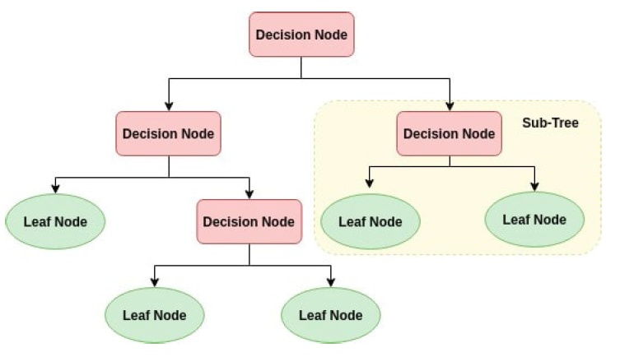
Model evaluation
Evaluate performance using metrics
Accuracy
Precision
Recall
F-1 Score
ROC-AUC
Model Optimization
Perform hyperparameter tuning
Use cross validation to improve genralization

Slide 7
MODEL USED
Support Vector Machine (SVM) is a supervised machine learning algorithm used for classification and regression tasks.
In this project, SVM is used to classify patients as diabetic or non-diabetic based on medical features.
Working Principle
SVM works by finding an optimal hyperplane that separates data points into different classes.
The goal is to maximize the margin, i.e., the distance between the hyperplane and the nearest data points (support vectors).
Only a subset of training data (support vectors) influences the model.
Kernel Functions
SVM uses kernel functions to handle non-linear data:
Linear Kernel
Polynomial Kernel
Radial Basis Function (RBF) Kernel (commonly used)

Slide 8
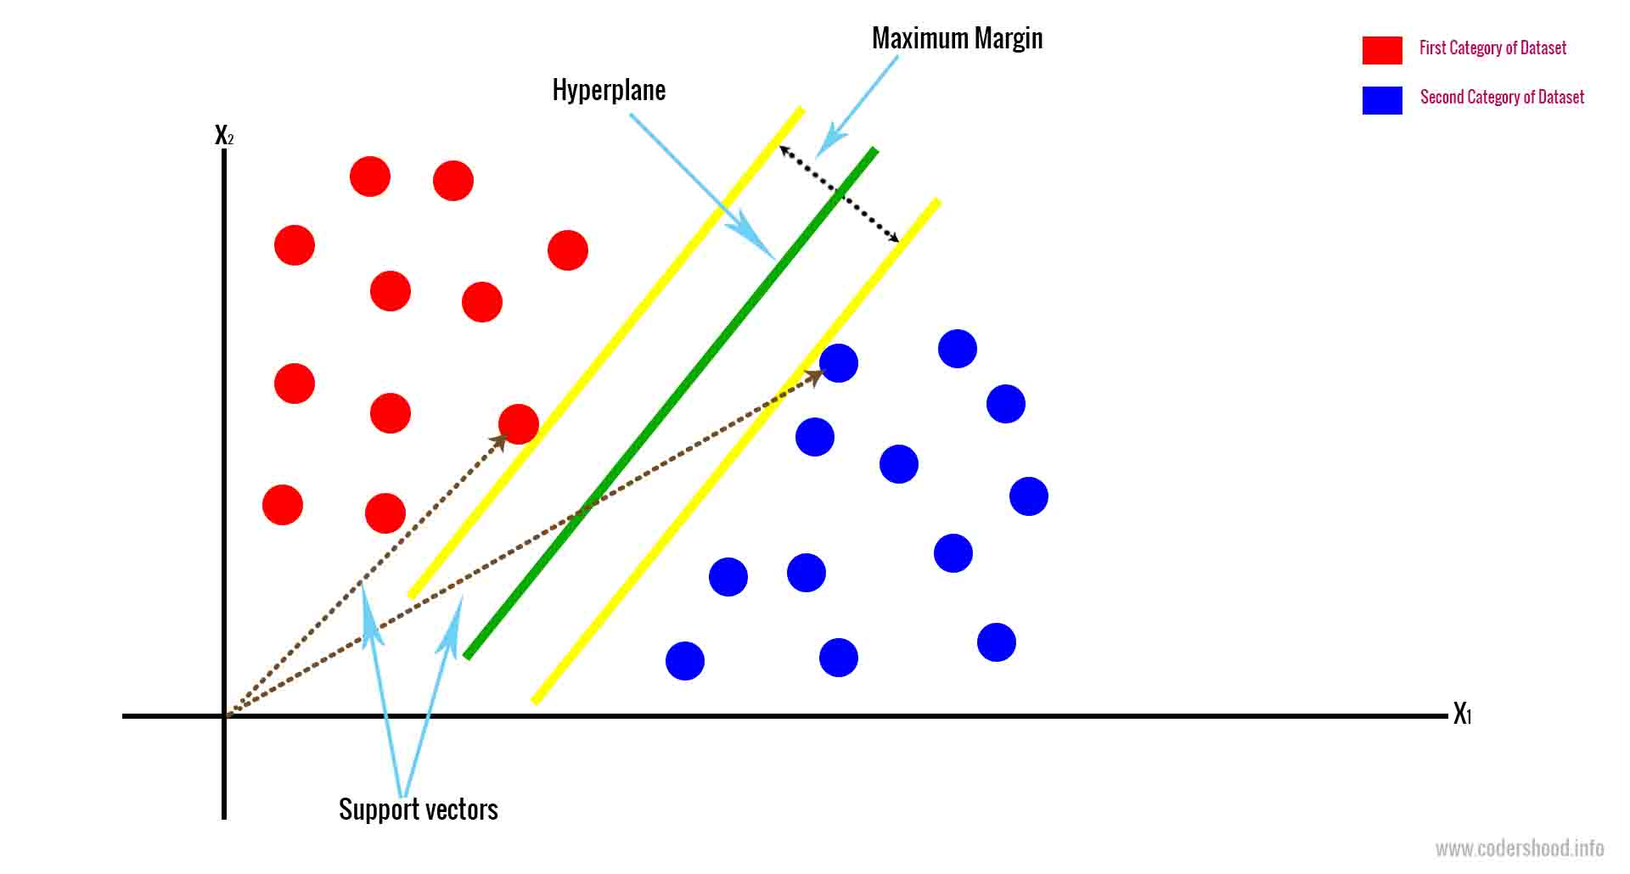
Why SVM for Diabetes Prediction?
Effective in high-dimensional spaces
Works well with small to medium-sized datasets
Handles non-linear relationships using kernels
Provides good generalization performance
Model Implementation Steps
Input preprocessed dataset
Select kernel function (e.g., RBF)
Train SVM model on training data
Tune hyperparameters (C, gamma)
Test model on unseen data

Slide 9
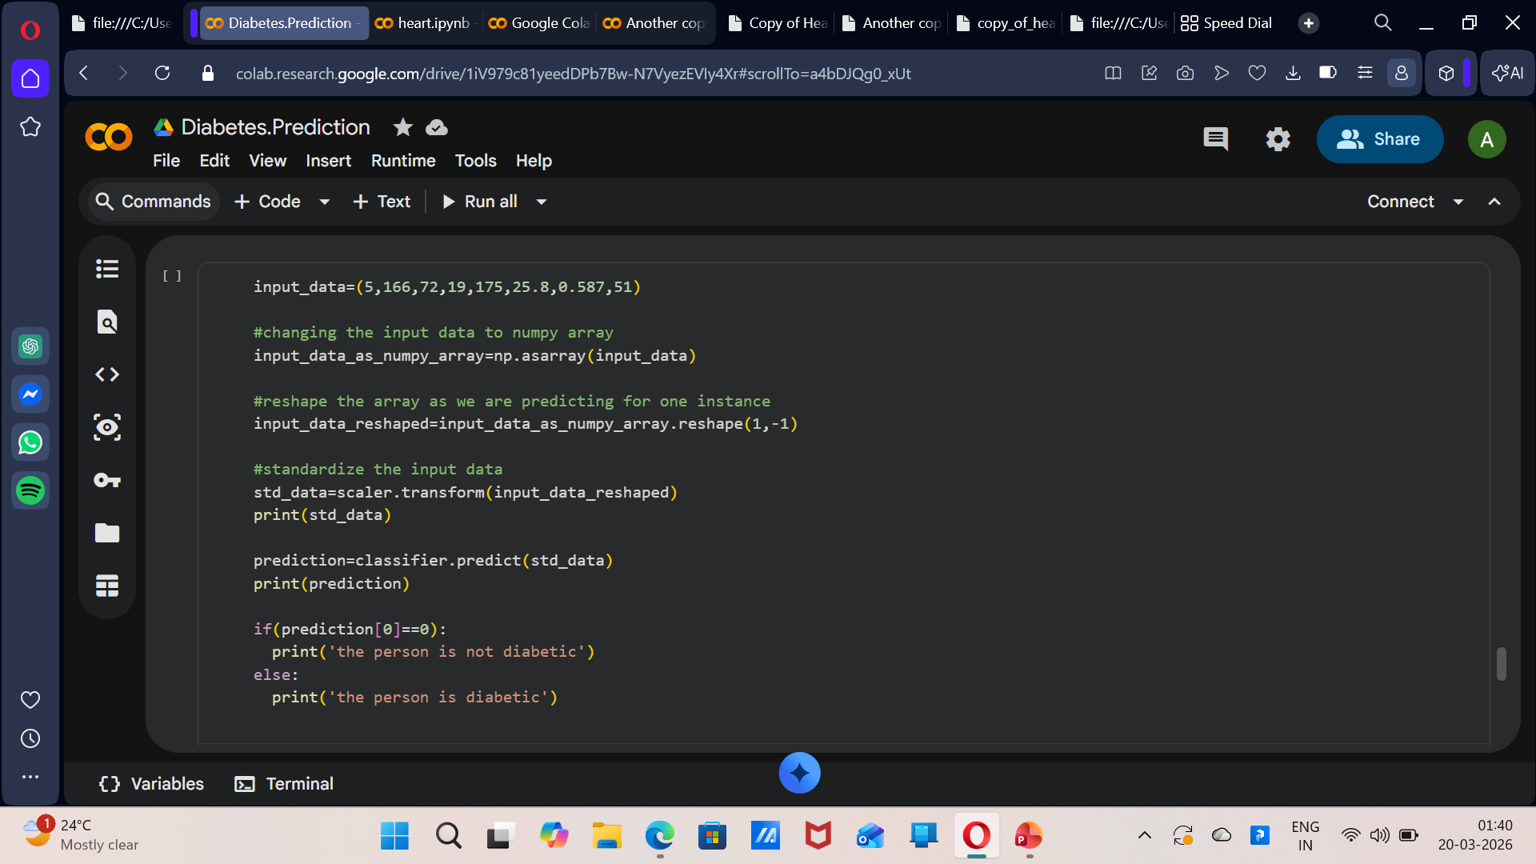
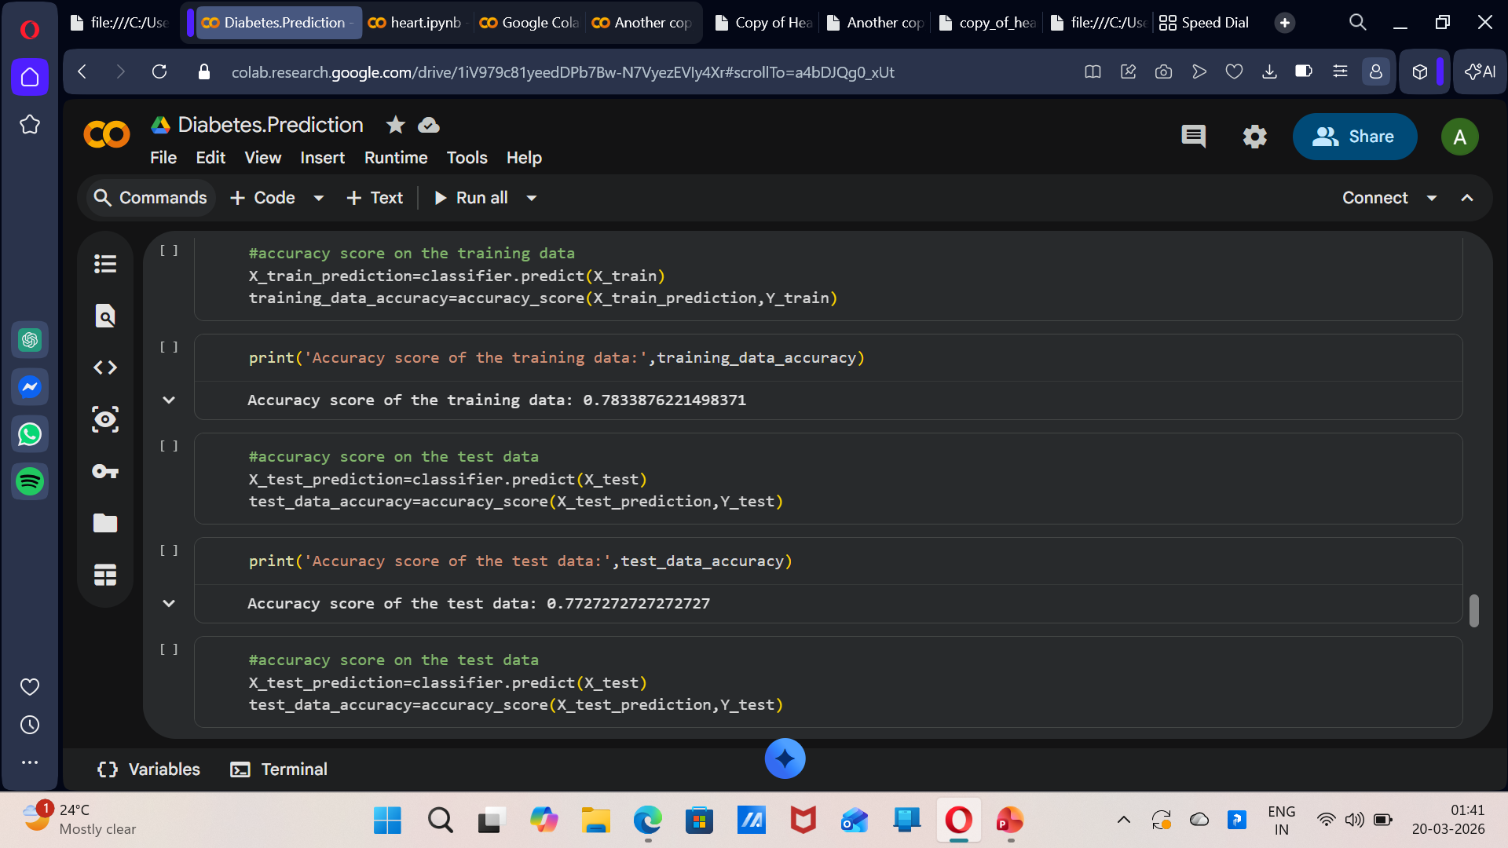
RESULTS
PREDICTIVE SYSTEM
ACCURACY STORE

Slide 10
CONCLUSION
This project demonstrates the effective use of Machine Learning techniques for
predicting diabetes at an early stage.
By utilizing medical parameters such as glucose level, BMI, age, and insulin,
the model can accurately classify individuals as diabetic or non-diabetic.
The implementation of the Support Vector Machine (SVM) algorithm provides
reliable performance with good accuracy and generalization capability.
Proper data preprocessing, feature selection, and model optimization significantly
improve prediction results.
The system can assist healthcare professionals in early diagnosis and
decision-making, reducing the risk of severe complications.
Overall, this approach highlights the potential of machine learning in enhancing
healthcare systems and promoting preventive care.

